Slide 1
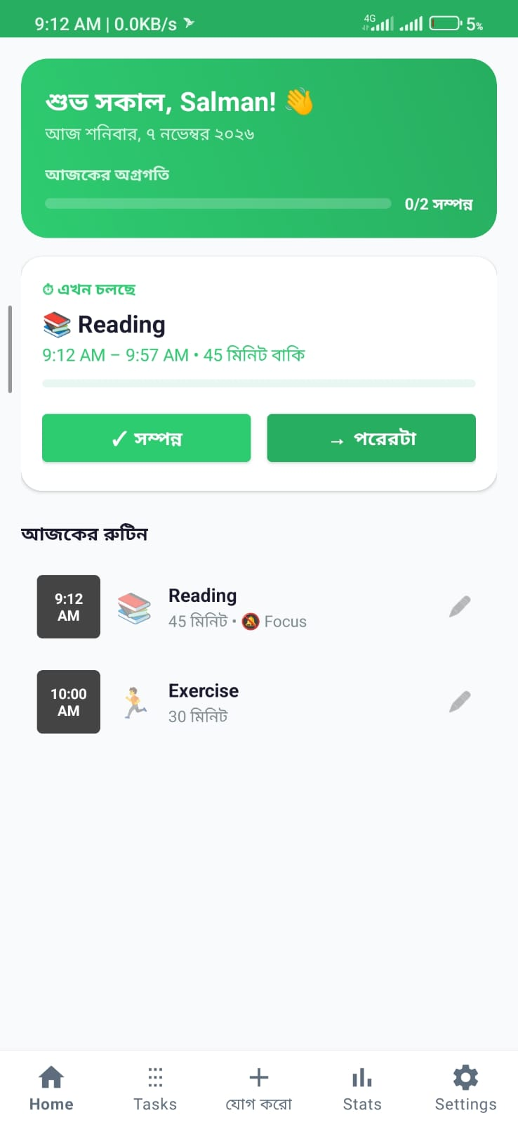
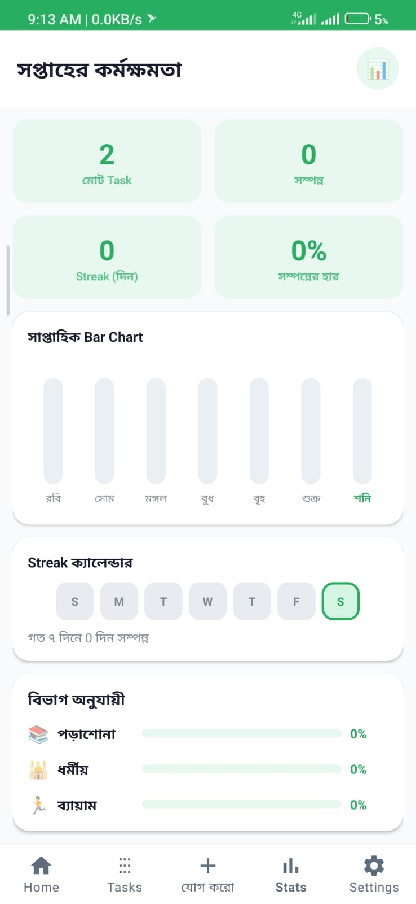
DailyFlow: Design and Development of an
AI-Integrated Android System for Intelligent
Routine Management, Focus Enhancement,
and Digital Distraction Prevention
Plan your day • Stay focused • Measure your progress
ANDROID
JAVA
SQLITE
DIGITAL WELLBEING
Presenter 1: Salman Akand | ID: 2110976160
Presenter 2: Washim Akram | ID: 2110276110

Slide 2
Problem Background & Motivation
Digital distractions and inconsistent routines
can undermine personal productivity.
The Core Challenge
Excessive time spent on social media and short-form videos.
Time Management + Digital
Distraction Control + Progress
Tracking
Managing study, exercise, rest and daily activities across disconnected tools.
Overlapping schedules and difficulty maintaining task consistency.
Bring these three needs together
in one integrated mobile app.
Limited visibility into personal progress, streaks and completion rates.
2

Slide 3
Proposed Solution: DailyFlow
An offline-first Android app that supports the complete workflow—from routine planning and distraction control to productivity review.
PLAN
FOCUS
EXECUTE
REVIEW
Add tasks, select categories,
and set time and recurrence
Enable Focus Mode and
block selected apps
Receive timely reminders;
complete or skip tasks
Review statistics, streaks
and weekly progress
One place for routines • focus • productivity tracking
3

Slide 4
Project Objectives & Scope
Routine Management
Schedule Conflict Prevention
Organise daily and weekly tasks by time, category and duration.
Prevent users from scheduling multiple tasks for overlapping time periods.
Digital Distraction Control
Productivity Measurement
Restrict access to selected apps and short-video content during focus periods.
Display completion rates, streaks and daily/weekly progress.
Current scope: Native Android (Java) • Local SQLite storage • Android system services and APIs
4

Slide 5
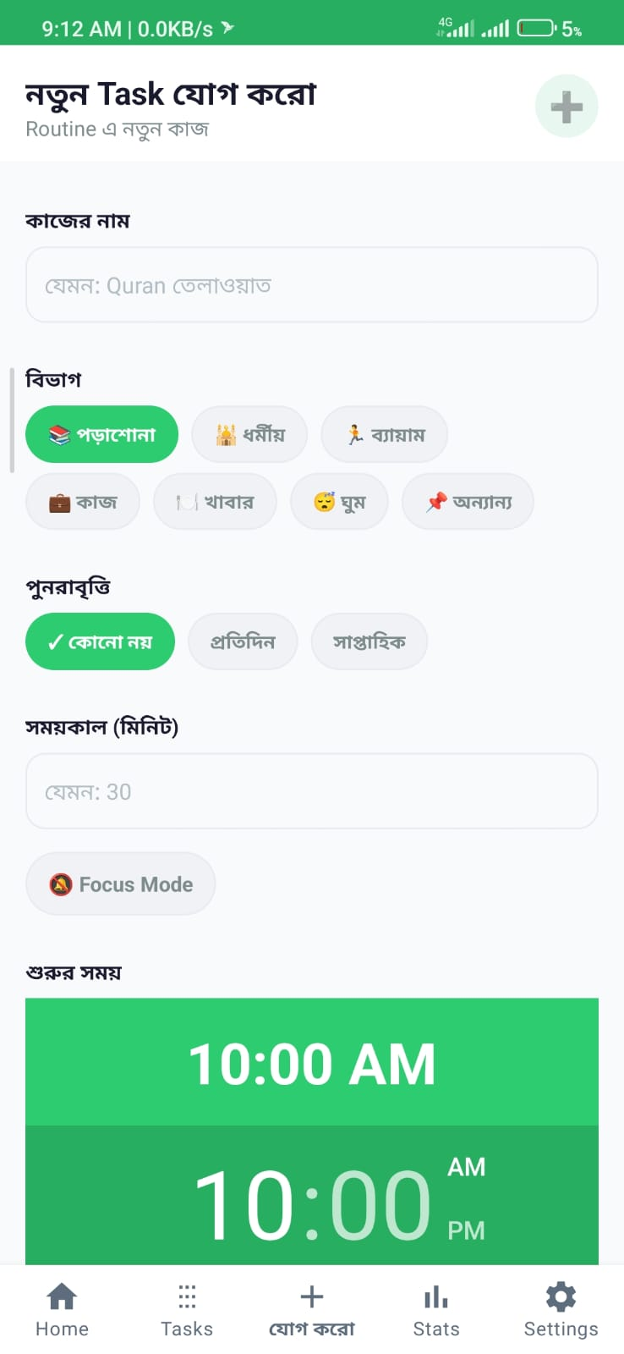
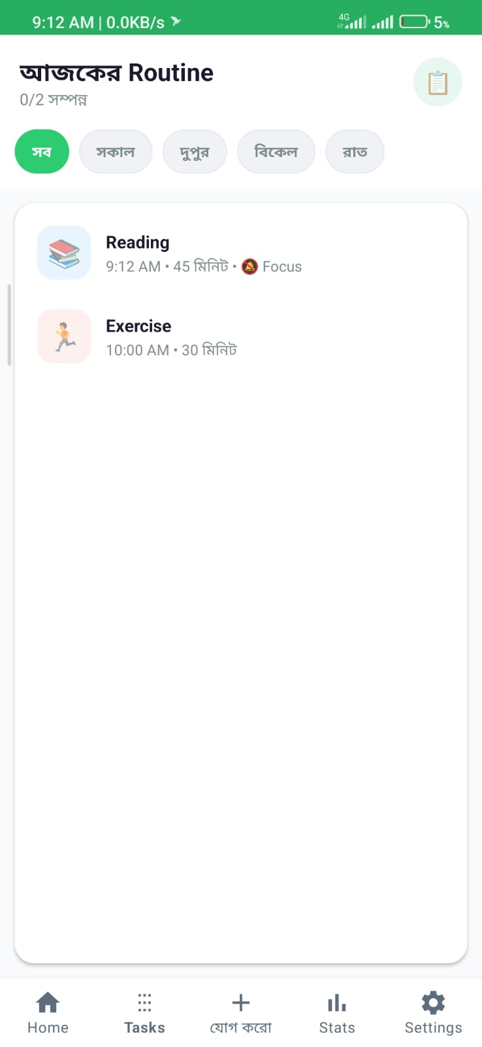
Routine & Task Planner
Users can organise their activities into a structured daily routine.
Categories: Study, Religion, Exercise, Work, Meals, Sleep and Others
Set task start times using the Android TimePicker
Specify task duration in minutes
Recurrence options: None / Daily / Weekly
Enable Focus Mode for selected tasks
Task states: pending, ongoing, completed, skipped and locked
Example: Reading — 45 minutes | Exercise — 30 minutes
5

Slide 6
Smart Scheduling & Conflict Detection
The system calculates each task's time interval and checks whether a new task overlaps with an existing one.
Example: Two Task Time Intervals
startA < endB AND startB < endA
10:00
11:00
Task A 10:00–10:30
If an overlap is detected, the new task is not saved.
Task B 10:20–10:50
The two time intervals overlap
Task lifecycle
pending
ongoing
completed
skipped
locked
Status updates are triggered by user actions or system rules
6

Slide 7
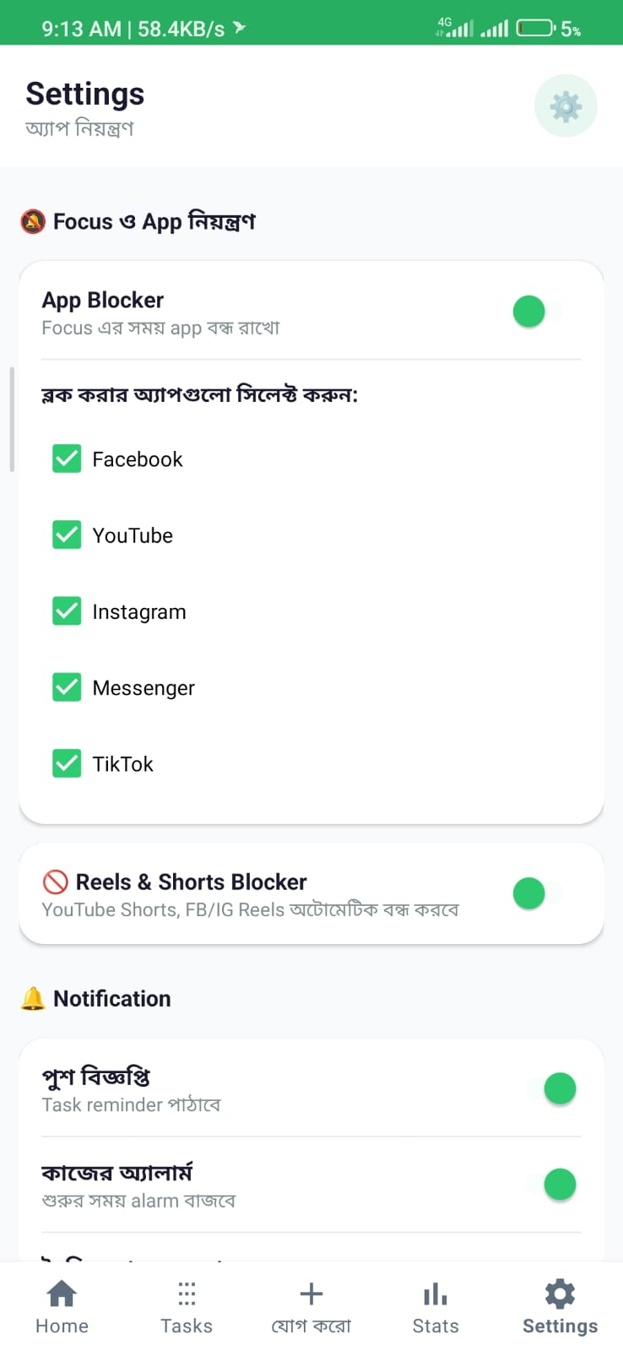
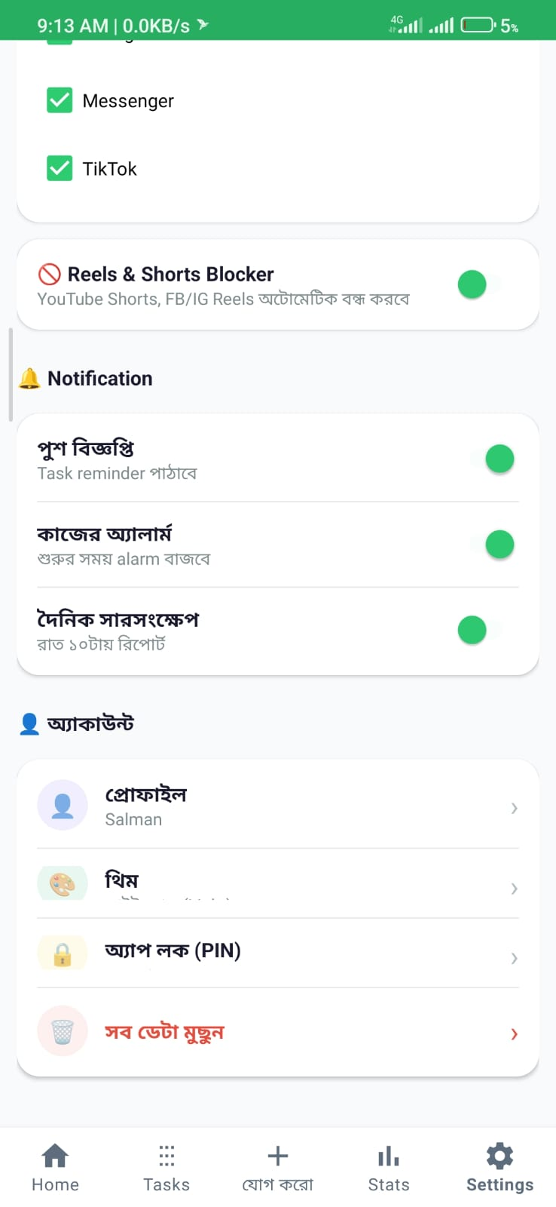
Smart Focus Mode & Full App Blocker
When Focus Mode is active, attempts to open selected distracting apps are detected and a custom blocking screen is displayed.
Foreground Service: AppBlockerService maintains background monitoring.
UsageStatsManager: Uses Usage Access to identify the app currently in the foreground.
WindowManager Overlay: Displays a custom lock or overlay screen when a selected app is opened.
User Control: Users can select Facebook, YouTube, Instagram, Messenger and TikTok.
7

Slide 8
Real-Time Reels & Shorts Blocker
Supported Content Detection
How It Works
YouTube Shorts
shorts_player, reel_viewer, remix
1
Receive Accessibility Service events
Facebook Reels
fb_shorts, reel_viewer, reels_video_view
2
Scan the view tree and resource IDs
Instagram Reels
clips_viewer, reels_viewer
3
Detect short-video interfaces
TikTok
feed video pager detection
4
Trigger a Back action and show a warning
Smart exception: Keep regular News Feeds and comment sections usable. When Reels or Shorts are detected, the system aims to trigger a Back action within approximately 500 ms; actual timing may vary by device and app version.
8

Slide 9
System Architecture & Technology Stack
PRESENTATION LAYER
Android UI • Home • Tasks • Add Task • Stats • Settings
APPLICATION LOGIC
Task Manager • Schedule Conflict Engine • Status Manager • Streak & Analytics
ANDROID SERVICES & APIs
AppBlockerService • ReelsBlockerService • UsageStatsManager • Accessibility • WindowManager • AlarmManager
LOCAL DATABASE | SQLite
PREFERENCES | SharedPreferences
DatabaseHelper.java • tasks • daily_history
PreferenceManager.java • profile • theme • blocker settings • PIN
Core data is stored locally to support an offline-first user experience.
9

Slide 10
Database Design & Local Data Management
tasks TABLE
daily_history TABLE
Task name
Total number of tasks recorded for each date
Category
Number of completed tasks recorded for each date
Repeat type (None / Daily / Weekly)
Start time & duration
SharedPreferences
Status: pending / ongoing / completed / skipped / locked
Focus Mode flag
Profile name • Light/Dark theme
App blocker status and selected apps
Reels blocker status • 4-digit PIN data
Created date
10

Slide 11
Analytics, Security & Notifications
Productivity Analytics
Security
Daily completion percentage
Weekly bar chart
Category-wise progress
Streak day counter
4-digit PIN lock
Protects routines and settings
User-controlled preferences
Reminders & Alerts
Personalization
Task reminder notifications
Start-time alarms
Daily summary at 10:00 PM
Light / Dark theme
Profile name
Notification preferences
11

Slide 12
Application Interface: Actual Screens
Home & Active Task
Add Task & Schedule
Weekly Productivity
Settings & App Blocker
Note: Screenshots show the current Bengali-language app UI.
12

Slide 13
AI-Enhanced Productivity: Key Capabilities
Potential intelligent support for routine planning, focus and productivity tracking.
AI Daily Routine Assistant
Natural-language Task Creation
Smart Schedule Optimizer
Builds an editable daily plan from goals, habits and available time.
Turns a plain-language request into a pre-filled task form.
Suggests conflict-free task times and practical breaks.
AI Productivity Analyst
Adaptive Focus Coach
Distraction Prevention Coach
Explains completion trends and highlights improvement areas.
Recommends focus-session lengths and breaks from usage patterns.
Provides timely, task-aware prompts during focus sessions.
Personal AI Chatbot
Answers questions about routines, pending tasks and progress.
13

Slide 14
AI Daily Routine Assistant
HOW IT WORKS
ILLUSTRATIVE EXAMPLE
Turns a user's goals and routine history into a practical, editable day plan.
USER INPUT
1
Collect goals and preferences
“I want to study for 2 hours, exercise for 30 minutes and sleep by 10:30 PM.”
Use selected goals, preferred time windows, task durations and routine preferences.
2
Review existing commitments
Read current tasks and available time slots; keep fixed commitments unchanged.
AI SUGGESTION
A draft routine could place study in a preferred high-energy period, add a 30-minute exercise slot and protect the user's chosen bedtime. Exact times depend on the user's calendar and preferences.
3
Generate a balanced plan
Suggest a sensible order for study, exercise, work, rest and other activities.
4
Explain and refine
Show why each time is suggested and let the user adjust the draft.
USER CONTROL
The plan is a suggestion, not an automatic change. The user reviews and confirms it before tasks are created or moved.
DAILYFLOW CONNECTION
Uses the existing task list, categories, durations and routine history to prepare a suggested daily schedule.
14
14

Slide 15
Thank You!
Questions & Discussion
15

